Slide 1
Dental and medical school admissions-are we doing it right?
Professor Rhoda MacKenzie
Aberdeen
Notes:
Good morning all,
Many thanks for inviting me to speak on the topic of admissions into dental and medical school. This has been one of my research themes for almost 10 years, and some of my work has informed the policy and practice of medical and dental selection in the UK. I am going to focus mainly on dentistry. However, where relevant, I will draw on work from medicine.

Slide 2
Admissions Procedures
Ensure service delivery in the future
Ensure patient safety
Select the best people for the job
Those who will make the “best” dentist or doctor
But…who is that?
Notes:
Looking at our admissions or selection procedures, what is it we are trying to do here?
At it’s most simplistic, read slide//… we are trying to pick the best candidates

Slide 3

What attributes do we want in a qualified dentist?
Notes:
IT depends who you ask!

Slide 4
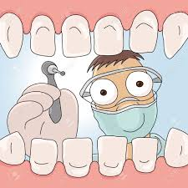
What qualities do we want in a dentist (when we are 10 years old)?
Nice
Kind
Gentle
Smell nice
Funny
Nice teeth
Good at fixing teeth
Notes:
I went to my daughters primary school and asked her whole P6 class what they wanted their dentist to be like. I hope you will join me in being very impressed by the wireless drill here

Slide 5
What adult patients want
Gentle
Kind
Honest
Good with their hands
Knows what they are doing/up to date
Friendly/chatty
Clean
Good listener
Explains options/procedures
Notes:
Ok, now we are getting to it

Slide 6
Important attributes wanted by dentists
Professionalism / Conduct
Clinical competence / Aptitude
Patient Focus
Compliance-related / Quality assurance
General Dental Council Revalidation Stage 1 Feasibility Study Final Report 2009
Notes:
This is what dentists think a dentist should be- a sample of 2000 dentists from around the UK. Grouped into 4 main areas and these are not a surprise to any of us.
So these, one would think, should be the relevant, sensible attributes we should base our admissions processes on.

Slide 7
Admissions processes in 2006
Academic attainment
Personal Statement
References
Interview
Notes:
So, about 10 years ago, these are what many dental and medical schools used for admission to university. Humble bragging.
Of course many of us predate this by several years, if not decades, many of us will have gained entry based solely on school grades and possibly the say so of our head teacher.
Now, academic achievement or cleverness in the words of the 10 year olds, did not come up in my earlier slides. More about that later.

Slide 8
Widening Access
Levelling the playing field for:
minority groups
those with disabilities
those from poorer socioeconomic backgrounds
Relatively short history of 20 years, starting with the Dearing report

Slide 9
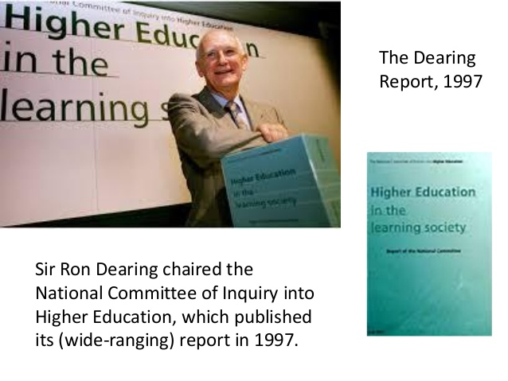
Notes:
The Dearing report was commissioned at time when UK higher education was in a mess. Policies had lurched from reducing the number of students to increasing them. Underfunding had left universities stretched to breaking point. The amount universities had to spend on teaching had halved, and funding for infrastructure and research had been reduced.
Sound familiar?

Slide 10
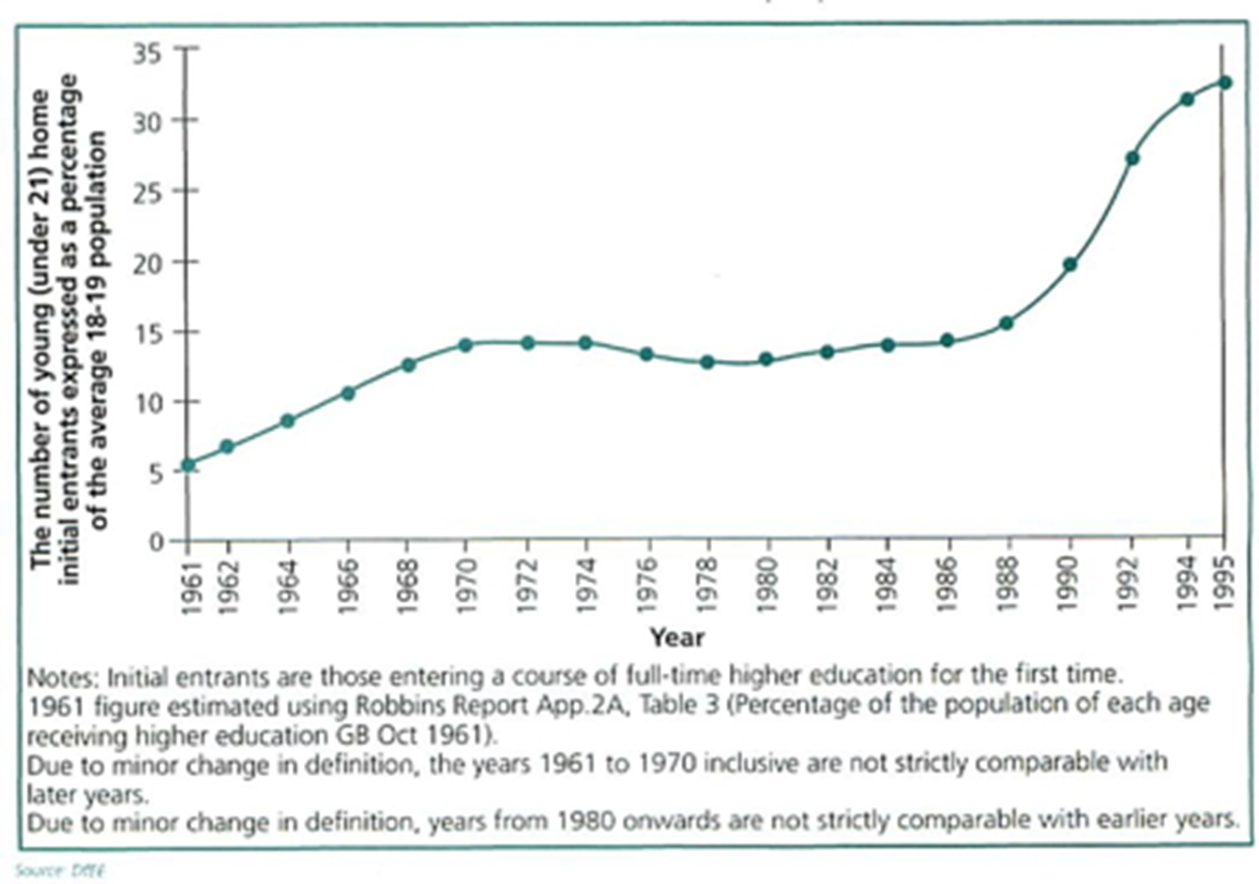
Dearing report
Economic analysis -benefits of widening access to HE – more graduates
Education as a means of improving the UK’s economic competitiveness in a global workforce market
  Individual gains (social mobility) secondary
Participation in HE had risen sharply in the 1990s.
But continued low rates of participation from
  social economic groups IV and V
  Those from less affluent neighbourhoods
Notes:
Dearing’s position was economic, that the UK needed graduates to have an internationally competitive workforce and that being a graduate was good for the individual as the evidence was that graduates earned more than non-graduates.
From this position, two main things happened. First, the Dearing report paved the way to the introduction of tuition fees and the scrapping of maintenance grants.
Click, Second, 1997 was also a time when there were relatively low rates of participation in HE. For example, I went to university in 1985 when about 13-14% of young people when into higher education. This rose to about 30% in 1990. Comparing with today’s figures, the most recent snapshots I could find for the UK indicated that participation of young people in HE varies from about 32% in Wales, to 55% in Scotland with England sitting at about 48%.
Click, Yet even with lower numbers, those in HE differed by socio-economic group.

Slide 11
Recommendations
Noted that there was two-tier system in which, because of perceptions in the labour market of the relative status of institutions, 'applicants progress from privileged pasts to privileged futures or from less privileged pasts to less secure and lower status futures‘
Recommendations part of a high level document, little practical advice.
Notes:
Dearing and his colleagues noted that there was two-tier system in which, because of perceptions in the labour market of the relative status of institutions, 'applicants progress from privileged pasts to privileged futures or from less privileged pasts to less secure and lower status futures‘.
The Dearing report recommended additional funding to support widening participation, both at national and local levels, but it was a very high level policy document – lots of facts and rhetoric but not much in the way of practical advice.

Slide 12
Notes:
It also let to this document, Fair admissions to higher education: recommendations for good practice which did what it said on the tin and set out suggestions for implementation of widening participation and fair access to higher education.

Slide 13
Schwartz Report 2004
5 key principles
Principle 1: A fair admissions system should be transparent
  Include a general indication of the weight given to prior academic achievement and potential demonstrated by other means.
Principle 2: A fair admissions system should enable institutions to select students who are able to complete the course as judged by their achievements and their potential
  Consider not just exam results, but other indicators of potential and capability such as prior non-academic experience, and how these could contribute to the learning environment
Principle 3: A fair admissions system should strive to use assessment methods that are reliable and valid
HEIs have instituted this in their own ways
Notes:
The Schwartz report set out five key principles or recommendations. These are all relevant to dental and medical admissions, but I have highlighted three here as these are most pertinent.
HE institutions have implemented these in their own way and admissions processes are now in a state of flux, often changing every other year.

Slide 14
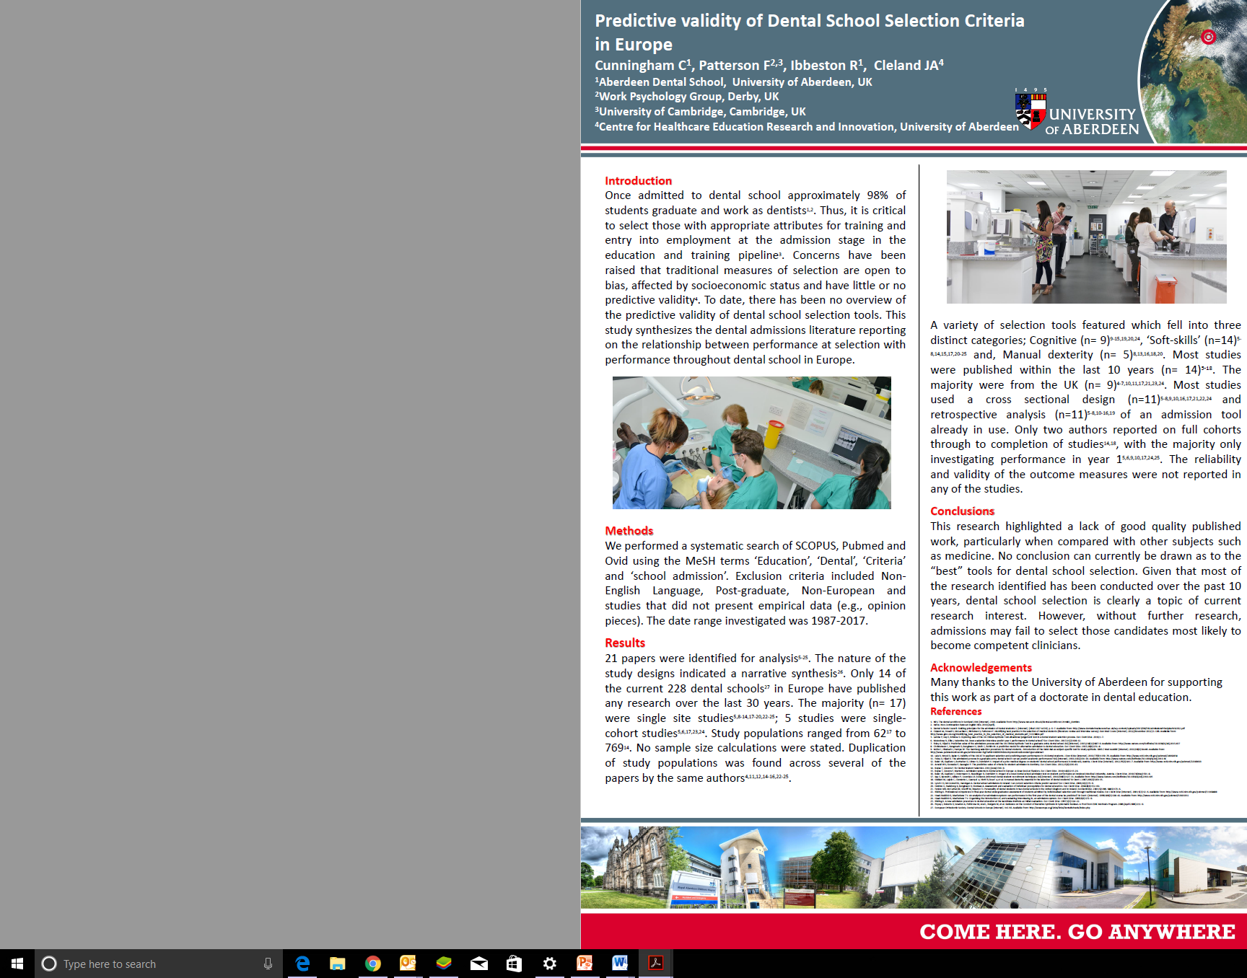
Review of dental selection literature
Paucity of research in dental admissions predictive validity
Majority of studies are single site
Opportunity for large-scale research
Notes:
If we look at research into dental school admissions, there is not much in the way of high quality published work. This represents a huge pool of data ripe for large scale research – something to discuss this afternoon

Slide 15
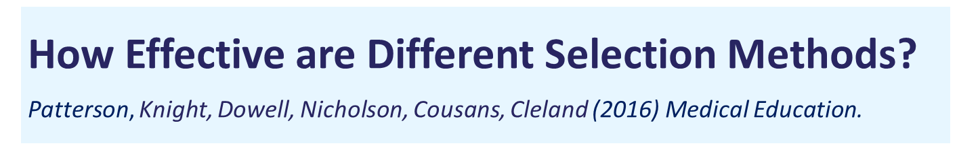
    Academic records
    Aptitude tests
    Personal statements
    References
    Situational Judgement Tests
    Personality & Emotional Intelligence
    Interviews & MMIs
    Selection centres
Systematic review
Notes:
This systematic review, carried out several years ago and updated last year looked at the literature on all medical selection tools.

Slide 16
Selection Method | Reliability | Validity | Candidate acceptability | Promotes widening access?
Academic records
Structured Interviews/MMIs
Situational Judgement Tests
Aptitude testing
Personality Tests
Traditional Interviews
Personal statements
References
Patterson, et al, 2016. How effective are selection methods in medical education and training? A systematic review. Medical Education.

Slide 17
Academic records
Most widely used selection method and hence also the best studied
Strengths | Limitations
Moderate predictor of HE academic performance | Less predictive of clinical performance
Generally administered by other bodies, so low cost to medical schools | A Levels/Highers are losing discriminating power/grade inflation
Standardised and well-recognised assessments | Big socio-economic class bias
 | UK research focuses on school-leaving exams, little known about the predictive validity of other qualifications
Notes:
There is the assumption that there is a linear relationship between very high entry grades and success in dentistry and medicine.
But is this the case?
Well, at best the correlations are moderate in relation to performance as a medical student, and decreasing across the years of the programme, and being much less in the clinical context. Moreover, a lot of these studies are quite old, and this is relevant given grade inflation - by this I mean that the discriminatory power of prior academic attainment may be diminishing as increasing numbers of medical school applicants have top grades. There are additional issues with prior attainment, such as the insistence of medical schools that all qualifications must be attained a one sitting. There is no evidence that this is important.
My own view is that there is no doubt you need to be reasonably good at learning and passing exams to do medicine, but the academic qualifications demanded for medicine have crept up not because of the marvellous predictive validity of school attainment for medical school attainment and performance as a doctor, but because of external factors such as grade inflation and internal factors like managing the numbers of applicants.
So we can’t say with much certainty that high prior attainment = good dentists or doctors.

Slide 18
Prior academic achievement?
Convenient way to cull huge number of applicants.
Accounts for 23% of variability of undergraduate and 6% postgraduate performance in medicine
Better predictive validity (of knowledge) in early years of curriculae, falling to very little by the end of the degree.

Slide 19
Prior attainment
Failing to gain the required grades - usually the first hurdle in admissions – is the most common cause of rejection
Yet attainment is hugely dependent on schooling
How much is enough to pass the course?
What about the use of “appropriate contextual criteria” (CA) in admissions?
Which CA to use?
Gorard, S., N. Adnett, H. May, K. Slack, E. Smith, and L. Thomas. 2007.
Overcoming the Barriers to Higher Education. Stoke-on-Trent: Trentham Books.
Notes:
Moreover, prior attainment is very closely linked to education. Good schooling leads to doing as well as one can – a disadvantaged education does not. There is huge inequality in our high school education and there are clear patterns of achievement by school, and by school type. For most people, the only school that is available to them is the one nearest them. If it is a good school, then great. If not, then they will not achieve as well. This is nothing to do with ability but it is to do with opportunity and access. For example, if a school lacks a chemistry teacher one year, and that is the year an individual is preparing for their A levels, or Highers, then they are disadvantaged.
Fascinatingly, those who attended fee paying schools actually do worse than those who went to non fee-paying schools, so although their grades get them in, they do worse in their exams.

Slide 20
Personal Statements
Lack of good quality research in relation to this selection method
Strengths | Limitations
Popular & widespread selection method | Less reliable than other methods
Some evidence of predictive validity in relation to medical school performance | Potential data contamination caused by external influences (e.g. length of time to complete application, third party influence, location, etc.)
Some evidence of candidate acceptance | Potential for plagiarism
 | Information inconsistently used during the decision-making process
 | Highly resource-intensive to mark
Notes:
So, in short the evidence for these tools is not overwhelming, and nor did this traditional triad fulfil the principles of the Schwartz report in terms of reliability and validity, and assessing on potential as well as prior achievement.

Slide 21
References
Little research examining the use of referee reports
Strengths | Limitations
Prevalent selection method in healthcare education | Clear consensus in the literature that poor predictors of performance
 | Information contained in reports may result in admission bias
 | Information inconsistently used by during the decision-making process
 | Varied candidate perceptions of acceptability
 | Highly resource-intensive to mark

Slide 22
Most widely used aptitude test in the UK
Parallel programme of independent (by tender) research
Over 30 published articles to date
Notes:
UK medical and dental schools did respond proactively, most obviously with the introduction of aptitude tests as a means of assessing potential, and with shifting towards interviewing. Whatever you think of the UKCAT, the way the consortium was set up has led to a lot of independent research, and a far more substantial body of research than is available for the other admissions tests used by UKCAT schools (BMAT and GAMSAT).

Slide 23
Personality & Emotional Intelligence (EI)
Overall, variable quality of research for this selection method
Strengths | Limitations
Common assessment method used across multiple industries | No significant link between some personality tools & performance (e.g. MBTI, etc.)
Moderate to significant links between some personality traits and performance | Certain traits may be associated with different levels of performance over the course of healthcare education (e.g. conscientiousness and pre-/clinical performance)
Traits linked to performance: Empathy and motivation → positive ‘Dysfunctional’ personality → negative | Could lead to a reduction in the diversity of personalities amongst medical students
 | Insufficient evidence to support use of EI in selection at present

Slide 24
Situational Judgement Tests (SJTs)
High quality research, including meta-analyses/systematic reviews
Strengths | Limitations
An increasingly popular method of assessment in healthcare | Method of construction & response instructions may affect validity
Strong predictor of job performance; also predicts performance above cognitive ability & personality tests | Mode of administration may affect candidate reactions (e.g. computer-based vs. video-based)
Positive candidate reactions | Some item types may be more susceptible to faking, practice & coaching effects than others
Evidence that coaching does not significantly impact on validity | Requires expertise to design effectively
Reliable method of assessment with low adverse impact to minorities
more predictive at the lower end of a scoring distribution | Maybe better used to “select out” candidates
Notes:
These are really rather good and can take the form of text only or videos.

Slide 25
Interviews & Multiple Mini Interviews (MMIs)
Widely used for many years
Format varies widely – ‘traditional’, structured and MMI
MMI increasingly popular, but design & implementation varies hugely
Strengths | Limitations
Means of assessing non-academic skills | Careful design is required to ensure good reliability
Good approach for some aspects, such as communication skills | Potential for bias (gender, ethnicity, SES)
High face validity | Resource intensive
Some evidence they can be ranked effectively | Rarely clear what content is actually assessed within a composite total score, especially with MMIs
May help screen out ‘unsuitable’ entrants | Historically little evidence of predictive validity, though changing as interviews become more structured
Notes:
Being used in increasing numbers of schools, but great differences on format and design, difficult to look at national results. The lack of a national exit exam makes it difficult to draw comparisons across multiple schools. A medical national assessment is in the offing and I believe this is also being discussed in dentistry, a great opportunity for national research.

Slide 26
Selection Method | Reliability | Validity | Candidate acceptability | Promotes widening access?
Academic records | High | High | High | Low
Structured Interviews/MMIs | Moderate to high | Moderate to high | High | Moderate
Situational Judgement Tests | High | High | Moderate to high | High
Aptitude testing | High | Various | Moderate | Moderate
Personality Tests | High | Moderate | Low to moderate | N/A
Traditional Interviews | Low | Low | High | Low
Personal statements | Low | Low | High | Low
References | Low | Low | High | Low
Patterson, et al, 2016. How effective are selection methods in medical education and training? A systematic review. Medical Education.

Slide 27
“Good with their hands”
Visual, spatial and manual dexterity stations in MMI
Mirror box
Beads/ball bearings
Sorting and stacking
Wire bending
Estimation of size
Tactile discrimination
Notes:
So lets get back to good with their hands. Several stations have been devisoed in MMIs.

Slide 28
Dexterity
Students can improve manual dexterity by learning
No studies showing a correlation between MMI dexterity stations and clinical performance – but no high quality studies
……perhaps could select out extremely poor performers?
Notes:
Small studies have shown in dentistry that it is possible to learn MD.
Never been a study that shows predictive validity for later performance, but the research is not good enough yet.

Slide 29
Widening Access
Levelling the playing field
“Getting in” vs “getting on” in HE
Notes:
Let us return to widening access

Slide 31

School – available from UCAS
School progression to HE rate (not Scotland)
School performance average
free school meals or registered for Education Maintenance Allowance

Slide 32

Neighbourhood – available from UCAS
Low progression to higher education neighbourhood – postcode/POLAR
Deprivation – only SIMD

Slide 33

Individual level – available from UCAS
Self-declared through UCAS Apply
Disability
First in family in HE
Been in care
Evidence of WA participation encouraged in personal statements

Slide 34
Admissions practice in 2017
Prior attainment
Admissions Test (UKCAT or other)
Interview – MMI or traditional
Much less weight put on personal statement/references
Potential/aptitude assessed

Slide 35
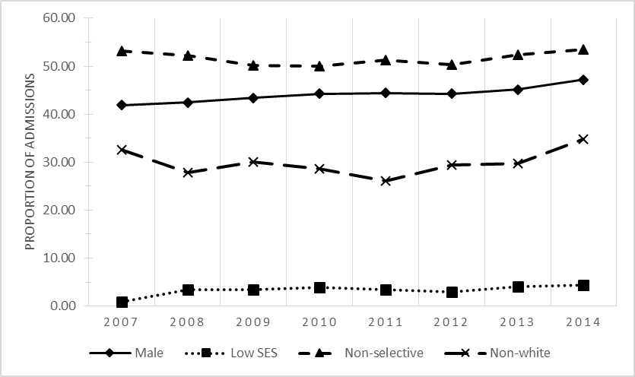
Student admissions to undergraduate programs at 18 UK medical schools from 2007 to 2014
Proportion of admissions in each target group from 2007 to 2014

Slide 36
Clear targets
Sets out the target to double the proportion of people from disadvantaged backgrounds entering university in 2020 compared to 2009
And the aim to ensure that providers properly support students from disadvantaged backgrounds to achieve their full potential

Slide 37


Slide 38
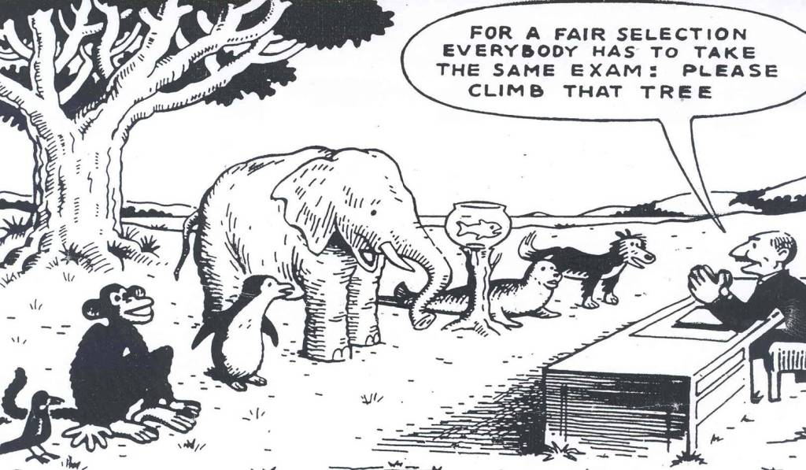
Notes:
It isn’t a level playing field

Slide 39
Selection in 2022?
Personal characteristics
Resilience, grit
Admissions Test (UKCAT or SJT)
Interview – MMI or traditional
Contextual factors (e.g., origin, careers preference)
Prior attainment (but less weight)
Academic selection based on what is needed?
Selecting out?

Slide 40
Future Admissions research
Future-orientated job analysis studies are needed to inform selection criteria: “What attributes are important to being an effective healthcare practitioner in the next 20 years and beyond?”
Use of job-relevant criteria to make selection decisions: the output of job analysis studies provides a list of job-relevant
knowledge, skills and attributes required for competence
More high quality, large scale and longitudinal studies required looking at predictive validity of selection methods- must be multicentre, not single site. Practical assessments must also be looked at.
Zibarras L, Patterson F, Driver R. A future research agenda for selection into healthcare.
European Journal Of Dental Education · June 2017

Slide 41


