Slide 1
An Investigation of the Optimization of PEEK Implant Osseointegration Using a New Biomaterial Coating
College of Medical,
Veterinary and Life Sciences
Noura Alotaibi 8th March 2017
Notes:
1

Slide 2
Supervising committee:
A: MVLS college
Prof. Ashraf Ayoub
Prof. Matthew Dalby
Dr. Kurt Busuttil Naudi
B: School of Biomedical Engineering
Prof. Manuel Salmeron-Sanchez
Notes:
2

Slide 3
OUTLINE:
Literature review
Aim of the study
Objectives

Slide 4
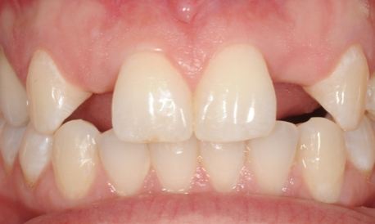
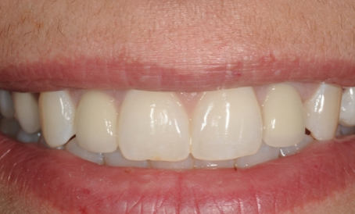
The replacement of missing teeth with dental implants has become the gold standard treatment .
Notes:
4

Slide 5
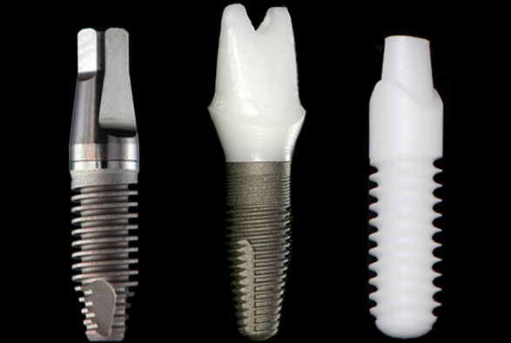
Different materials have been introduced as dental implant including titanium, titanium alloy, zirconium and PEEK.

Slide 6
Implant material requirements
Biological compatibility
Mechanical compatibility
Morphological compatibility
Imaging & esthetic compatibility
Notes:
6

Slide 7
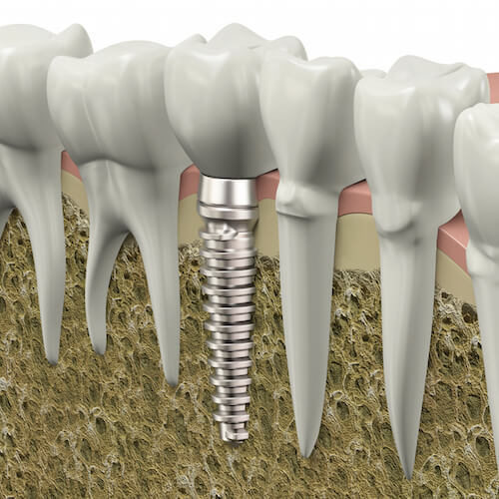
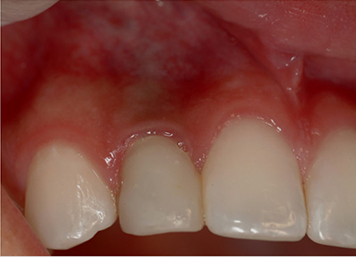
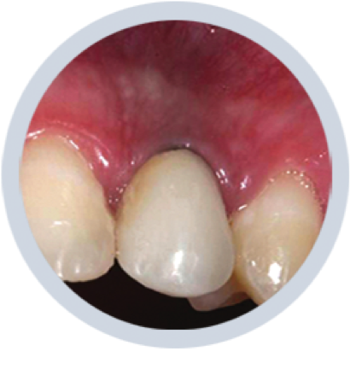
Limitation of Titanium Implant
elastic modulus stress bone loss
esthetic problems
hypersensitivity ( 0.6 % rare)
Patient demand
Notes:
Titanium, and its alloys, have been proven to have excellent biocompatibility and osseointegrative properties. but
Due to this stiffness implant don’t strain the bone adequately which can result in disuse atrophy
difference in the elastic moduli of a titanium implant and its surrounding bone This may cause stress in the implant-bone interface
during load transfer
7

Slide 8
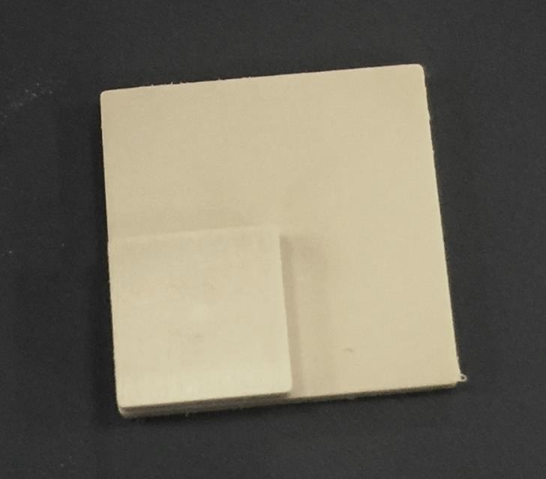
PEEK (polyetheretherketone)
thermoplastic polymer
light coloured
excellent chemical & biomechanical properties
stable at high temperature (334C°)
resistance to chemicals and radiation
Notes:
composed of an aromatic backbone molecular chain connected by ketone and ether functional groups between aryl rings which has the formula
8

Slide 9
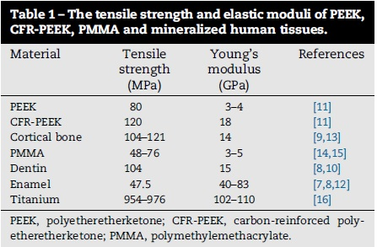
Interesting characteristic of PEEK
elastic modulus modified / carbon
(Najeeb et al, 2016)

Slide 10
Theoretically
PEEK could exhibit lesser stress-shielding when compared to
titanium.

Slide 11
PEEK
bioinert (hydrophobic)
Therefore recently a large amount of research has been conducted to modify PEEK osseoconductive property.
Notes:
prevents the cellular response to this surface

Slide 12
Spin coating
Plasma gas treatment
Plasma ion immersion implantation
(Najeeb et al, 2016)
Notes:
Different modalities have been introduced to increase the PEEK bioactivity including PEEK surface treatment, coating, and composite combination with bioactive materials.

Slide 13
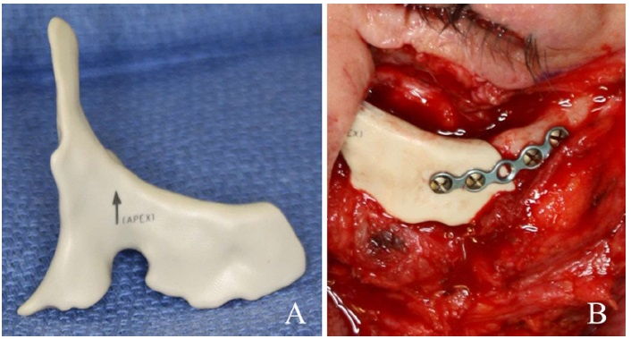
PEEK Medical Application
Maxillofacial CAD/CAM
Craniofacial
Spine surgery
Orthopedic
Cardiac
Notes:
In the last decades, PEEK implant has been used in orthopedic and spinal surgery.
This is a biocompatible material that had very good results in some studies of hip replacement, fracture fixations and spinal prostheses.
13

Slide 14
To the best of our knowledge, there are only two reports on the clinical application of PEEK for dental implantology.

Slide 15
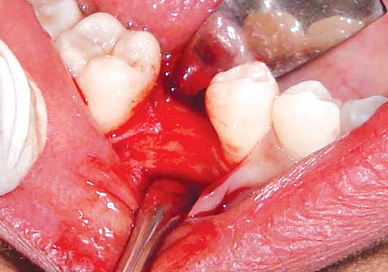
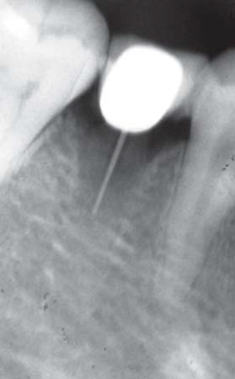
PEEK Dental Implant
3 cases
Different loading
Anterior /posterior
Marya et al , 2011
Notes:
15

Slide 17
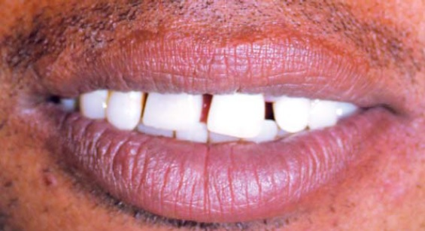

Slide 18
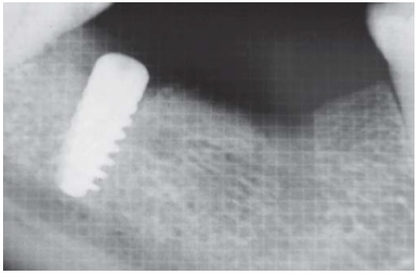
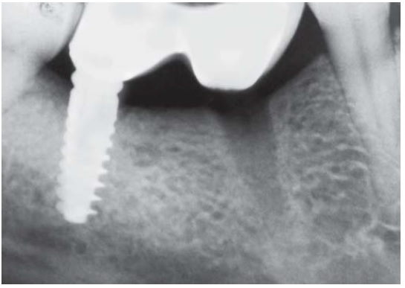
radiolucency
Immediate RG
3 months F/U
Notes:
Should I put CA of this paper ??
18

Slide 19
Khonsaria et al (2014), reported three cases of failed PEEK implants with severe infection .
Authors conclude that poor osseointegration led to severe infections and implant loss among these cases.
Notes:
Both paper present the same implant BIOPIK
19

Slide 20
However, PEEK dental implants have not been extensively used clinically and there is insufficient data to deduce their long-term efficacy in human subjects .

Slide 21
College of Medical,
Veterinary and Life Sciences
Aim:
In-vitro :
To assess the feasibility to develop bioactive PEEK implant by characterizing and modifying the surface.
In-vivo :
To assess the PEEK oseointegration in animal model.
Notes:
The target outcome would be an improved and rapid response of human bone marrow mesenchymal cells with respect to osteoblastic differentiation around the surface of the material compared to other implant materials. This would in theory improve the quality and stability of the bone/implant interface.
Another important outcome could be the reduction of the osseointegration time around the implant. This would result in reduced bone healing times in the pursuit of perfection in the hard tissue response to dental implants.
21

Slide 22
Objetives
To characterize the properties of the PEEK surface.
To characterize the polymer (PEA) coating, assuring its homogeneity, wettability and thickness.
To identify the fibronectin adsorbtion on the polymer(PEA).

Slide 23
To evaluate osteogenic differentiation of mesenchymal stem cells.
To evaluate cell responses to the delivery system of BMP-2 on PEEK.
To evaluate osseointegration.

Slide 26
Several biomaterial studies showed a different type of substrates that could facilitate FN fibrillogenesis.
Vanterpool et al. (2014) showed that PMA induced a globular solution conformation of FN while PEA has the ability to regulate the formation of FN fibrillar networks upon adsorption on the surface.

Slide 27
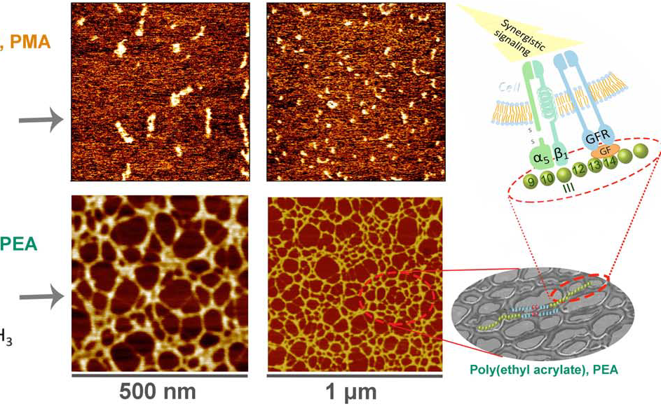

Slide 28
In-vitro
BMP
BMP
BMP
BMP
BMP
FN
PEA
PEEK
Notes:
28

